Slide 1


Configuration Management
and Ansible

Slide 2



Course : Mastering DevOps
Lecture On : Configuration Management and Ansible

Slide 3
Configuration Management

Slide 4
Configuration Management
What is configuration management?
It is the practice of tracking operational items and their attributes
Configuration management is a process for maintaining computer systems, servers, and software in a desired, consistent state
It is a way to ensure that a system performs as expected as changes are made over time
Example: An airline tracks the components and parts in its aircraft for safety and maintenance purposes. If a particular component is recalled for safety reasons, the airline can immediately determine where the component has been installed

Slide 5
Need for Configuration Management
It enables the ability to scale infrastructure and software systems without having to correspondingly scale administrative staff to manage those systems
Manual effort is to determine which system components should change when requirements change
Lost productivity by replacing system components with flawed new versions, without the ability to quickly revert to a working state
Unexpected outages from incorrectly modifying system components because you could not accurately determine which components were affected by a change

Slide 6
CM: Advantages
Easier scaling: Act of adding more resources (usually servers) to our running application
Uptime and site reliability: With our configuration managed properly, test environments can mimic production and can quickly revert to a working state
Disaster recovery: If the worst does happen, it ensures that our assets are easily recoverable
Cost reduction: Cost reduction is possible by gaining detailed knowledge of all the elements of your configuration
Auditing: Strict control of your processes by defining and enforcing formal policies and procedures

Slide 7
CM: Best Practices
Early testing
Performance testing
Integrate early and often
Track changes
Configuration control

Slide 8
CM: Types
Pull-based
  The nodes pull the configuration information from the server
  The nodes are dynamically updated with the configurations that are present in the server
  Examples: Chef and Puppet
Push-based
  A centralized server pushes the configurations on the nodes
  The main server initiates communication, not the nodes
  Examples: Ansible and SaltStack

Slide 9
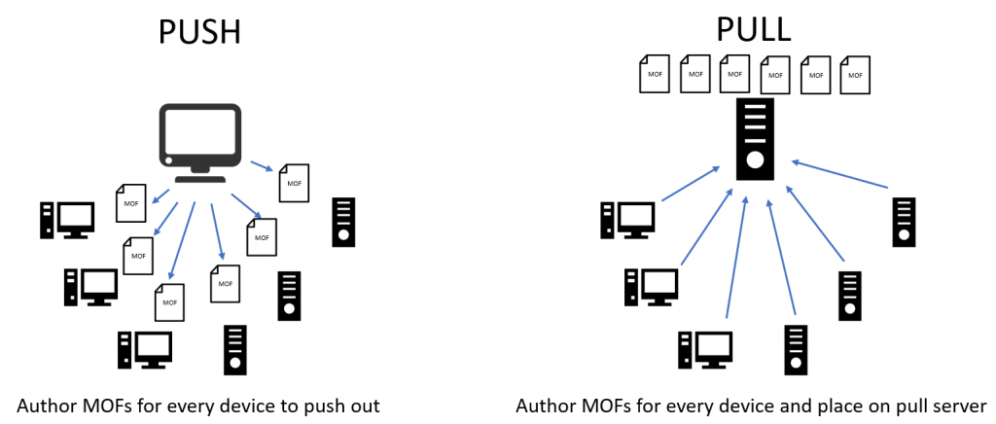
CM: Types

Slide 10
IaC vs CaC
Infrastructure as Code entails defining environments, including networks, servers, and other compute resources, as a text file (script or definition) that is checked into version control and used as the base source for creating or updating those environments
Configuration as Code: This approach involves defining the configuration of your servers, code, and other resources as a text file (script or definition) that is checked into version control and used as the base source for creating or updating those configurations

Slide 11
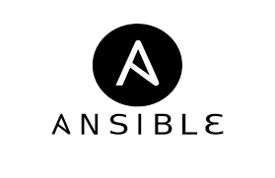
Ansible: Introduction

Slide 12
Ansible
Ansible is an open-source, radically simple IT automation system. It handles configuration management, application deployment, and ad hoc task execution
It is popular for its simplicity of installation
It functions by connecting via SSH to clients
Ansible uses playbook to describe automation jobs, and playbook uses a very simple language, i.e., YAML

Slide 13
Why Ansible?
Low learning curve, an easy descriptive language based on YAML
More readable syntax
Uses SSH and is minimal in nature
Setup is easy
Architecture includes only clients

Slide 14
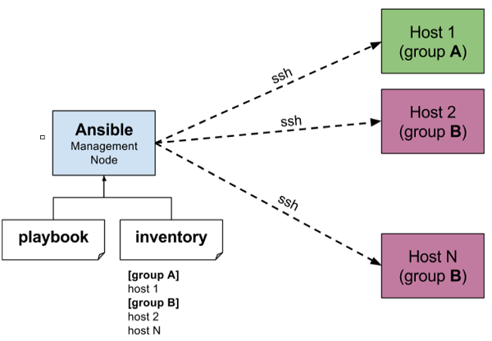
Ansible: Working

Slide 15
Inventory
Client details, such as hostnames or IP addresses and SSH ports, are stored in files called inventory files
Default inventory file: /etc/ansible/hosts.
You can specify a different inventory file at the command line using the -i <path> option
You can also place different servers in a group

Slide 16
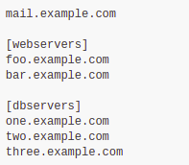
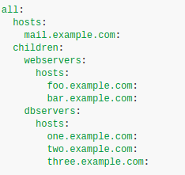
Inventory

Slide 17
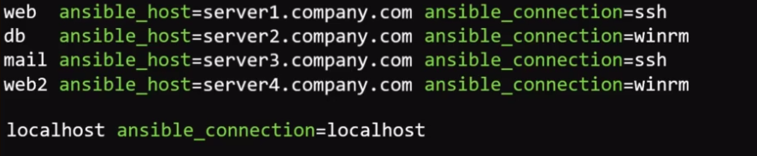
Inventory Parameters
ansible_connection - ssh/winrm/localhost
ansible_port - 22/5986
ansible_user - ubuntu/administrator
ansible_password - Password

Slide 18
Ad hoc Commands
Ad hoc commands are commands that can be run individually to perform quick functions
Format
  ansible <nodegroup> -m <modulename> -a <arguments>
ansible all -m ping
ansible webserver -m ping -i custom-inventory-file

Slide 19
Ad Hoc Commands
ansible all -m copy -a "src=/etc/hosts dest=/tmp/hosts"
  Copy file from the Ansible server to nodes
ansible webservers -m file -a "dest=/srv/foo/a.txt mode=600"
  Changing the permission of a file on all nodes
ansible webservers -m service -a "name=httpd state=started"
  Ensure a service is started on all web servers
ansible all -m setup
  To view all the facts about a system

Slide 20
Demo 1: Getting Started
Installing Ansible
Default inventory file
Custom inventory file
Running ad hoc commands

Slide 21
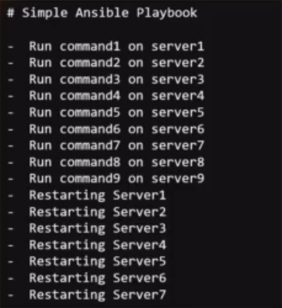
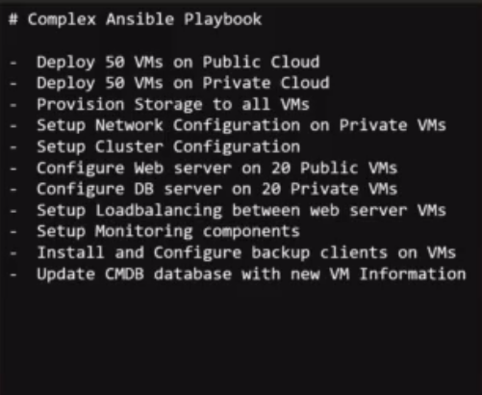
Playbooks
Playbooks are files in which Ansible code is written. Playbooks are written in the YAML format
In playbooks, we define what we want Ansible to do

Slide 22
Playbooks
Play: Defines a set of activities (tasks) to be run on hosts
Task: An action to be performed on the host
  Execute a command
  Run a script
  Install a package
  Shut down/Restart
Run: ansible-playbook <playbook file name>

Slide 23
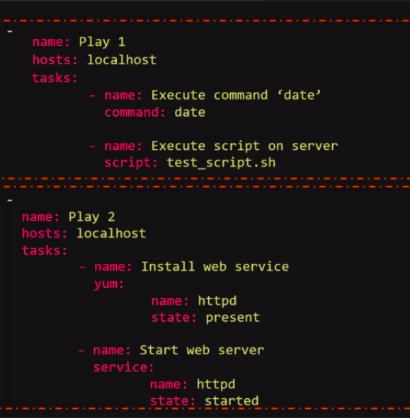
Playbook: Example

Slide 24
Modules
Ansible modules are discrete units of code that can be used from the command line or in a playbook task
They are also referred to as “task plugins” or “library plugins”
You can execute modules from the command line:
  ansible webservers -m service -a "name=httpd state=started"
  ansible webservers -m ping
  ansible webservers -m command -a "/sbin/reboot -t now"

Slide 25
Modules
system
commands
files
database
cloud
windows
more

Slide 26
Demo 2: Playbooks
Writing the first playbook
Defining tasks: Install and reload nginx
Executing playbooks
Define script, command, copy module

Slide 27
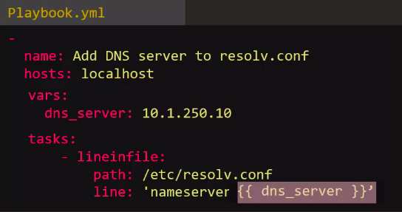
Variables
Help you use and assign a value to a variable and use that anywhere in the playbook
Store information that varies with each host

Slide 28
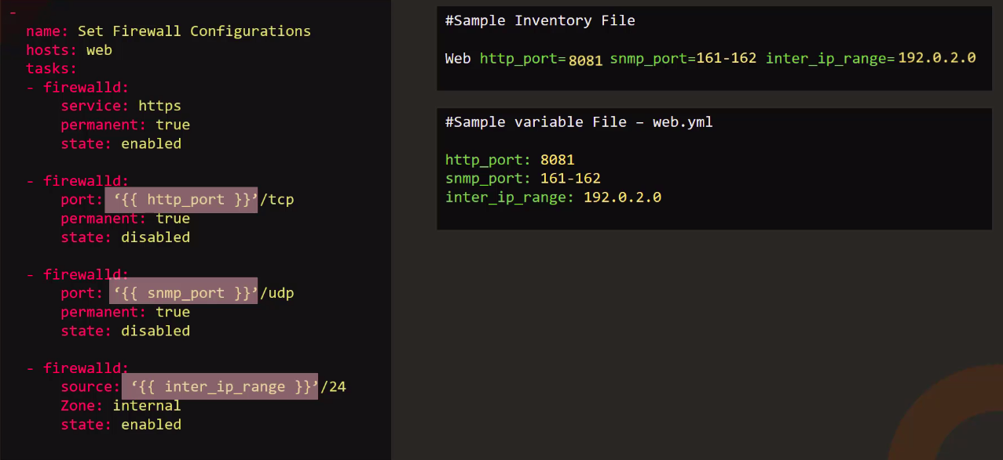
Variables

Slide 29
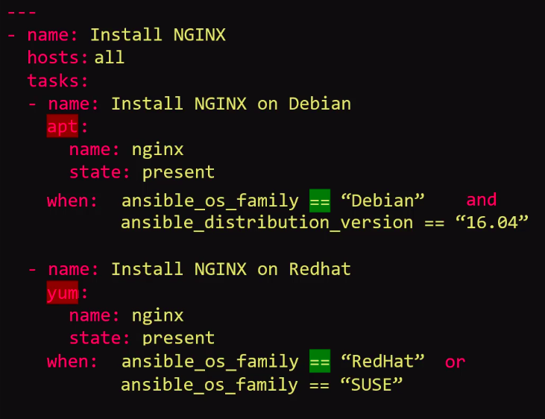
Condition
To execute different tasks, or have different goals, depending on the value of a fact (data about the remote system), a variable, or the result of a previous tas
Ansible uses Jinja2 tests and filters in conditionals

Slide 30
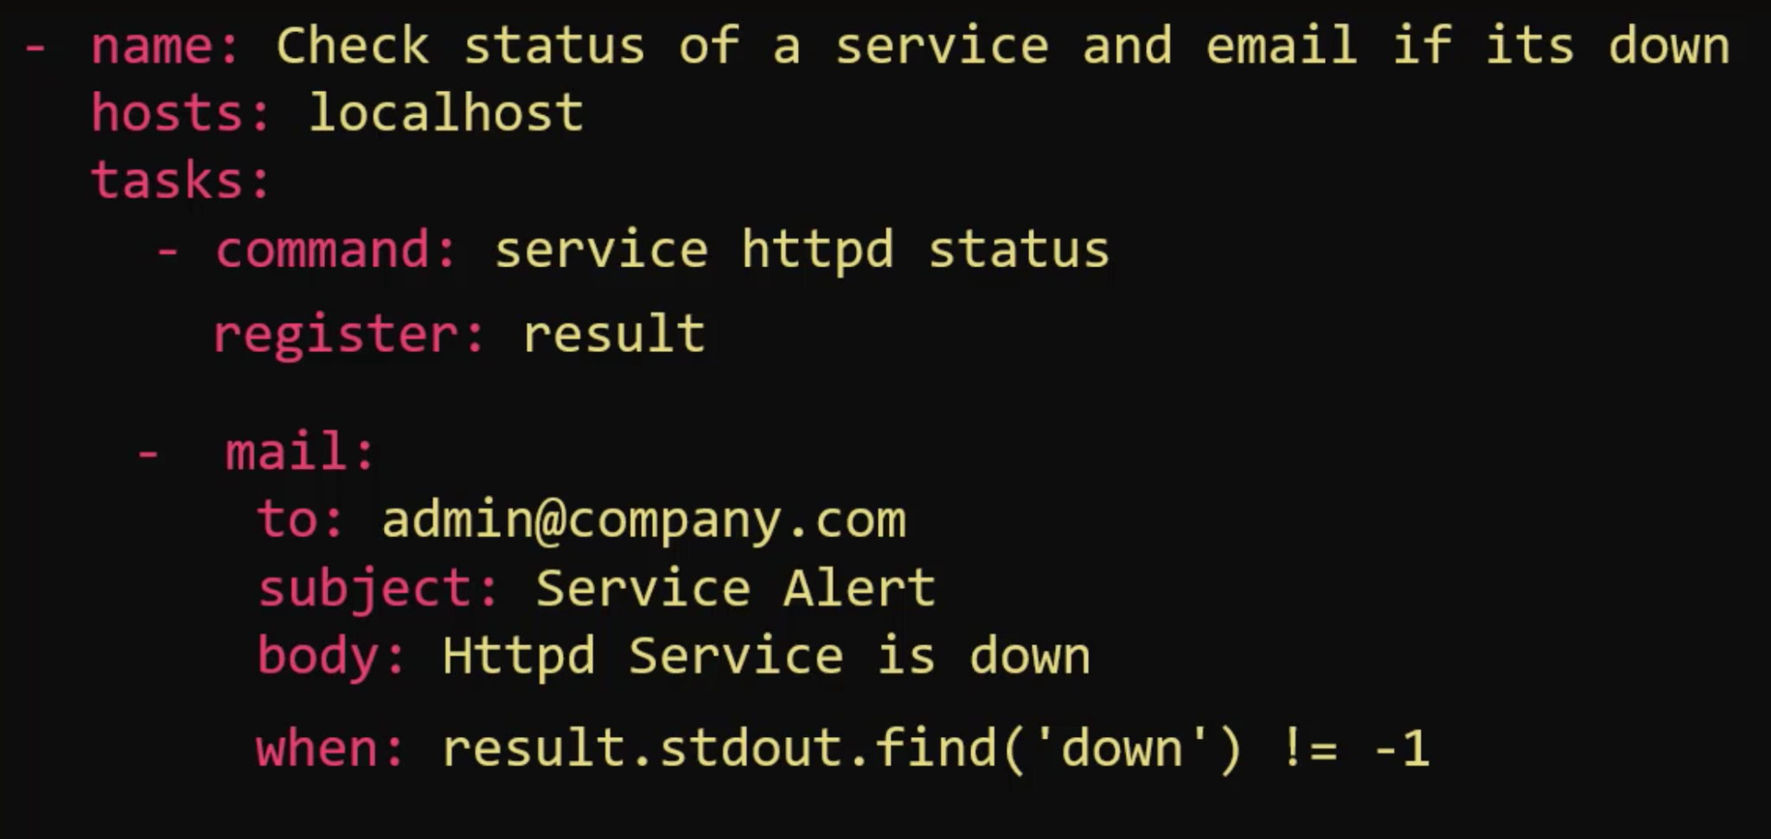
Condition

Slide 31
Demo 3: Variables, Condition, and Loops
Use of variables
Condition use to install nginx
Loops usage

Slide 32
Roles
Roles provide a framework for fully independent or interdependent collections of variables, tasks, files, templates, and modules
The Ansible role is an independent component that allows the reuse of common configuration steps
Roles let you automatically load related vars_files, tasks, handlers, and other Ansible artifacts based on a known file structure
Roles are defined using YAML files with a predefined directory structure

Slide 33
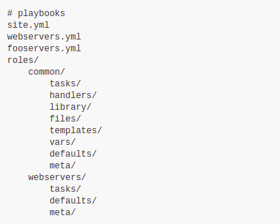
Role Directory Structure

Slide 34
Role Directory Structure
A role directory structure contains the directories defaults, vars, tasks, files, templates, meta, and handlers. Each directory must contain a main.yml file
defaults: Contains default variables for the role; variables in default have the lowest priority. So, they are easy to override
vars: Contains variables for the role; variables in vars have higher priority than variables in the defaults directory
tasks: Contains the main list of the steps to be executed by the role
files: Contains files that we want to be copied to the remote host; we do not need to specify a path of resources stored in this directory

Slide 35
Role Directory Structure
templates: Contains a file template that supports modifications from the role. We use the Jinja2 templating language for creating templates
meta: Contains the metadata of role such as an author, support platforms, and dependencies
handlers: Contains handlers that can be invoked by “notify” directives and are associated with service

Slide 36

Role Usage
By default, Ansible looks for roles in two locations:
  in a directory called roles/ relative to the playbook file
  in /etc/ansible/roles
Alternatively, you can call a role with a fully qualified path

Slide 37
Ansible Galaxy
It is a free site for finding, downloading, rating, and reviewing all types of community-developed Ansible roles
The client ansible-galaxy is included in Ansible
It provides an excellent default framework for creating your own roles
Usage
  ansible-galaxy [delete|import|info|init|install|list|login|remove|search|setup] [--help] [options] ...

Slide 38
Demo 4: Ansible Roles
Role folder structure
Ansible galaxy
Creating and using roles

Slide 39
Dynamic Inventory
Keeping tabs on the hosts defined in the inventory file becomes challenging in cloud environments
A dynamic inventory is a script written in Python, PHP, or any other programming language
Advantages of a dynamic inventory over a static inventory:
  Dynamic inventories do a perfect job of reducing human error, as information is gathered using scripts
  Minimal effort is required in managing inventories

Slide 40
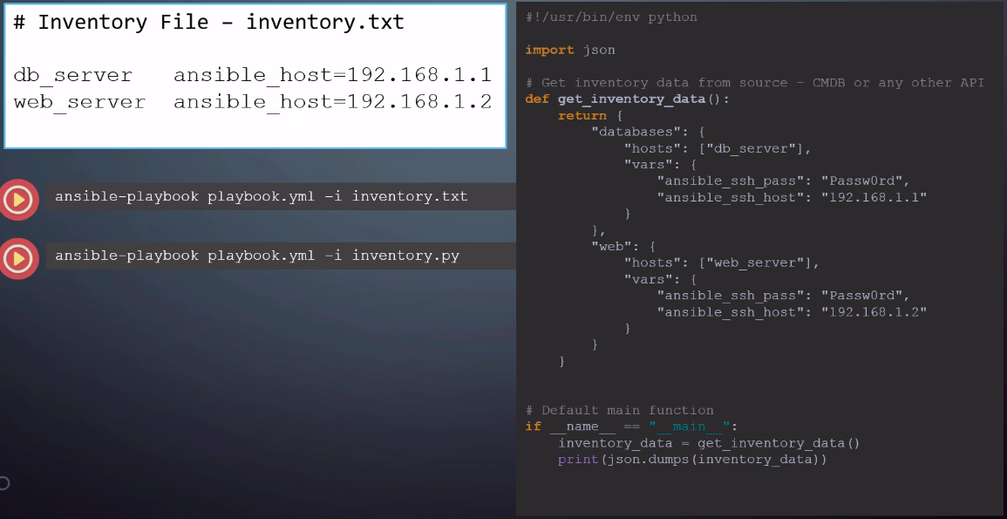
Dynamic Inventory

Slide 41
Dynamic Inventory
Pre-requisites:
  Boto must be installed on the Ansible server to make AWS API Calls
    sudo yum install python-pip python-wheel
    pip install boto
  Ansible servers should be able to carry out SSH on nodes
Setting up EC2 External Inventory Script With Ansible
https://docs.ansible.com/ansible/latest/collections/amazon/aws/aws_ec2_inventory.html

Slide 42
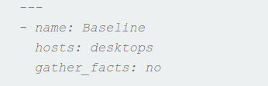
Advanced Execution
It is for optimizing and getting some more speed out of the setup
Disable fact gathering in Ansible
  gather_facts: no
Limit execution by hosts
Limit execution by tasks
failed_when and changed_when Statements

Slide 43
Running Tasks in Parallel
Ansible uses forks to execute tasks in parallel
Each fork can run a task against a target host
By default, Ansible runs the same task in 5 hosts in parallel
This configuration can be changed:
  Using the “forks” parameter definition in the ansible.cfg file
  By informing it in the command line (e.g., ansible-playbook myplaybook.yml --forks=10)

Slide 44
Demo 5: Dynamic Inventory
and Advanced Execution
Dynamic inventory implication
Advanced execution
  Turning off gathering facts
  failed_when and changed_when Statements
  Forking

Slide 45
Jinja2 Templating
Ansible uses Jinja2 templating to enable dynamic expressions and access to variables. The template module is extremely useful for carrying out machine-specific configuration based on Ansible variables
The Ansible template module transfers templated files to remote hosts. Its working is similar to that of the copy module but with two major differences:
  The Template looks for templates in ./templates/ when you supply a relative path for src (instead of ./files/ for copy)
  You can use the jinja2 templating language in your files, which will be templated out separately for each remote host

Slide 46
Templating
The Jinja variables and expressions are indicated using the default delimiters as follows:
{% … %} for control statements (conditions)
{{ … }} for expressions (variables)
{# … #} for comments (describe the task)
https://www.linuxtechi.com/configure-use-ansible-jinja2-templates/

Slide 47
Ansible Vault
The Ansible Vault encrypts variables and files so that you can protect sensitive content such as passwords or keys rather than leaving it visible as plaintext in playbooks or roles
To use the Ansible Vault, you need one or more passwords to encrypt and decrypt content
If you store your vault passwords in a third-party tool such as a secret manager, you need a script to access them
se the passwords with the ansible-vault command-line tool to create and view encrypted variables; create encrypted files; encrypt existing files, or edit, re-key, or decrypt files

Slide 48
Ansible Vault
It uses the AES256 algorithm to provide symmetric encryption keyed to a user-supplied password
This means the same password is used to encrypt and decrypt content
  To encrypt a file: ansible-vault encrypt nginx.yaml
  cat nginx.yaml ?
  To decrypt a file: ansible-vault view nginx.yml
  To edit a file: ansible-vault edit nginx.yaml

Slide 49
Demo 6: Jinja2 and Vault
Jinja2: Basic execution
Jinja2: Conditional execution
Using Ansible Vault
Integrating Terraform with Ansible

Slide 50
Important Concepts and Questions

Slide 51
Important Questions
What is configuration management? List some of its advantages
Differentiate between push- and pull-based tools
What is Ansible? How does it work?
What is the purpose of the ad hoc command? Is it necessary to run it each time?
Explain the usage of the inventory file
What is an ansible playbook?
What is the use of variables and conditional loops in Ansible?

Slide 52
Doubt Clearance Window

Slide 53
Tasks to Complete After Today’s Session
MCQs
Conceptual Questions
Project Checkpoint

Slide 54
Thank You!

